Slide 1
Enjoying the Right to
Play in Guatemala

Slide 2
How to Use This Resource
For use in your classrooms to discuss a story or topic with children and young people.
PART
1
Filled with activity ideas for building greater understanding on the themes within the story as well as ideas for taking the learning out into the world.
Throughout the pack you will see some items labeled with stars. These are to give you, as the educator, an idea of the level at which the content is pitched.
  One Star: For children in early years settings and/or those more confident with simpler concepts.
  Two Stars: For children and young people who have a good level of comprehension and reflection ability.
Three Stars: For young people with the confidence and maturity to explore more challenging themes,
concepts and ideas.
PART
2
(Kindergarten to Grade 3)
(Grade 4 to Grade 8)
(Grade 9 to Grade 12)
Always review content before using it within your setting. The notes section in each slide provides additional guidance and information.

Slide 3
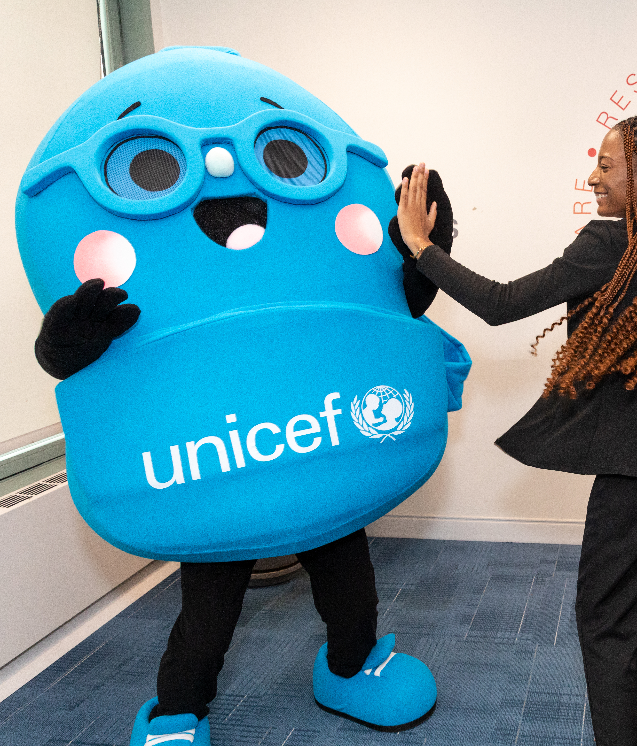
About UNICEF
UNICEF stands for the United Nations Children’s Fund. We were established in 1946 after World War 2 and today we work in nearly every country (more than 190 countries and territories) to protect children’s rights.
Our work includes health, nutrition, water, education, emergency response and so much more. Everything we do is to protect children’s rights around the world.
UNICEF is the only organization named in the Convention on the Rights of the Child as an official expert helper and adviser.
Notes:
Prep Note: Refer to the Rights, Needs and Wants Activity to help explain children rights and the Convention on the Rights of the Child to your students.

Slide 4
Presentations for Classroom Lessons
PART
1

Slide 5
Let’s Visit
Guatemala

Slide 6
Traveller’s Guide
T
The name Guatemala comes from an Indigenous word meaning “place of many trees.”
About 18 million people live in Guatemala, making it the most populous country in Central America.
Spanish is the official language of Guatemala and there are many Indigenous Mayan languages spoken, such as K’iche and Q’eqchi.
Guatemala City
Guatemala has two coastlines, the Pacific Coast in the West and the Caribbean Sea in the East.
The colourful quetzal bird is the national bird of Guatemala.
Guatemala has lots of volcanoes, about 30 of them! And many are active!
Notes:
Prep Note: Edit the facts suit your audience. Boxes can be deleted if you would prefer to focus on fewer facts.
Sources:
Volcanoes in Guatemala: https://kids.nationalgeographic.com/geography/countries/article/guatemala
National bird – the quetzal: https://kids.britannica.com/kids/article/Guatemala/345699
“Place of many trees” in Nahuatl: https://www.britannica.com/place/Guatemala
Coastlines of Guatemala: https://www.cdc.gov/yellow-book/hcp/americas-caribbean/guatemala-and-belize.html#:~:text=Guatemala%20is%20bordered%20by%20Mexico,Pacific%20Ocean%20to%20the%20southwest.
Languages spoken (Spanish and Mayan languages): https://kids.britannica.com/kids/article/Guatemala/345699
Population (largest in Central America): https://www.britannica.com/summary/Guatemala

Slide 7
Intro to UNICEF in Guatemala
UNICEF’s work in Guatemala is guided by the UN Convention on the Rights of the Child, which Guatemala ratified in 1990.
UNICEF works across Guatemala to help keep children healthy, safe, and able to learn. They support families by preventing child malnutrition, especially in areas affected by drought, and provide mobile health units that check children’s growth and wellbeing.
UNICEF also helps protect children who are migrating or have been forced to move, making sure they are safe and have emotional support during their journey.
UNICEF works with the government to create safe spaces, promote sports for girls, and improve access to clean water and sanitation. Their programs focus on giving every child the chance to go to school, feel safe, and have opportunities for a brighter future.
Notes:
Prep Note: Use this slide to make the link to UNICEF’s work.
You may wish to explore what the word ‘ratified’ means with your students. When a country ratifies a law, it means that they have agreed to it. In other words, when a country 'ratifies' the CRC it means that the people in charge (government) agree to do all they can to make sure children have their rights.
Background Note: Learn more about UNICEF in Guatemala: https://www.unicef.org/guatemala/en

Slide 8
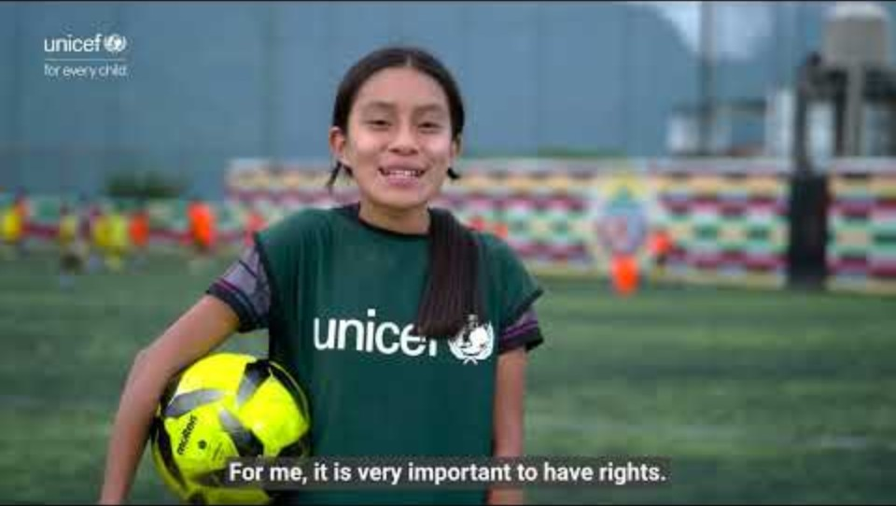
Guadelupe's Story
In this video, we meet Guadalupe, a young girl from Sololá in Guatemala, who shares her experience of playing soccer and learning about her rights. Speaking from the sidelines of a soccer training session, she reflects that having access to play gives her confidence, a sense of belonging, and the chance to have her voice heard. Guadalupe’s story highlights how sport can be a powerful way for children to understand their rights and feel empowered in their communities.
Notes:
Prep Note: Slide 9 and slide 10 offer the same content in different levels of detail.
Select the slide that is most appropriate for your students.
Remember to play the video full screen, and you have the choice to display captions.

Slide 9
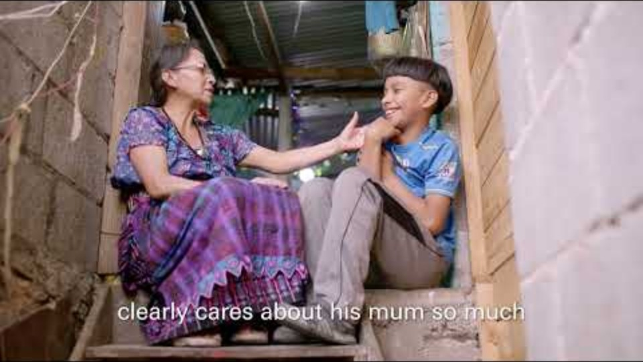
Adan's Story
In this video, Sam Thompson - a British podcast host and content creator – meets Adan, a young boy who has faced challenges in his life but is now finding new hope through soccer.
Thanks to a UNICEF-funded program, Adan has access to free coaching, giving him a safe space to play, learn new skills, and build confidence. His story shows how sport can open doors, helping children overcome difficulties, build resilience and imagine a brighter future.
Notes:
NOTE: This video mentions experiences of bereavement in early childhood.
Prep Note: Slide 8 offers the same content in different level of detail. Slide 21 includes information about Soccer Aid for UNICEF, which is mentioned in the video.
Select the slide that is most appropriate for your students.
Remember to play the video full screen, and you have the choice to display captions.
You may want to watch the One Star video (Slide 8), showing how access to play is helping more girls get involved in soccer through UNICEF's work. It highlights how breaking down barriers to participation not only builds confidence and skills on the pitch but supports wider opportunities for girls to thrive in their communities.

Slide 10

The Rights Link...
Think about the rights that you know.
Which articles of the Convention on the Rights of the Child (CRC) are particularly relevant to this case study?
Why do you think we’ve highlighted this selection?
Did you identify others?
Notes:
Prep Note: You may wish to have copies of the CRC available if your students are less familiar with the articles from the convention.
Animation Note: Click to reveal some examples.

Slide 11
...and what about the Global Goals?
Why do you think we’ve highlighted this selection?
Did you identify others?
Notes:
Prep Note: If your students are not currently familiar with the Sustainable Development Goals, please remove this slide or refer to the additional context provided in the Educator Resource Kit. To find out more about the Global Goals: https://worldslargestlesson.globalgoals.org/ or https://globalgoals.org/.

Slide 12
...and what about the Global Goals?
Why do you think we’ve highlighted this selection?
Did you identify others?

Slide 13
Reflection
What new things did you learn about children’s rights from the videos?
What similarities or differences do you notice between your daily life and the lives of the children in the videos?
How do you think the children in the videos felt when their rights were supported?
How could you or your school help make sure all children are treated fairly and have their rights respected?
Notes:
Prep Note: Before ending the session, encourage students to reflect on what they have learnt. You could ask them to share their reflections in pairs, small groups or to the whole group.

Slide 14
Activities
PART
2

Slide 15
Build Your Understanding
Guadalupe’s story reminds us that play is more than just fun. It is a right that every child should enjoy.
Think about play
Talk with your class about the importance of play.
What do you like to play?
How does playing make you feel?
Why is it important for every child to have time and space to play?
Show it Through Art
Draw a picture of your favourite game, sport or way to play. You could show yourself playing with friends, working as a team or having fun at a playground. Think about what makes play special and how it helps children learn, have fun and feel included.
Share Your Story
Create a class gallery called The Right to Play! Display your pictures in the classroom or school to help others understand why play matters and why every child should have the chance to enjoy it.
Notes:
Prep Note: The activities here will support students to explore this topic in more detail. Choose one or more activities as featured here or amend them to suit your class. You could also create your own activities inspired by the presentations in part one.

Slide 16
Build Your Understanding
Adan found new opportunities through free soccer coaching, where he can play, learn new skills and build confidence. His story shows how access to safe and welcoming spaces to play can help children learn, connect with others and feel supported. But not every child has the same opportunities to play.
Explore the Right to Play
In small groups, discuss the following questions:
Why is play important for children’s learning, health, well-being and relationships?
What opportunities do children in our school or community have to play?
Are there children who might face barriers to playing? What might make it difficult for them to participate?
Design a Play-Friendly Community
Work together to create a plan, model or illustrated map of a school or community where every child can enjoy their right to play. Use paper, recycled materials, drawings and other classroom supplies to bring your ides to life.
….continued on next slide.
Notes:
Prep Note: The activities here will support students to explore this topic in more detail. Choose one or more activities as featured here or amend them to suit your class. You could also create your own activities inspired by the presentations in part one.

Slide 17
Build Your Understanding
Include:
Places to play: Where can children play, take part in sports or spend time together?
Ways to participate: What games, sports or activities could children enjoy, regardless of their abilities, backgrounds or experience?
Removing barriers: What could make it easier for all children to participate, feel safe and be included?
Children’s voices: How can children help decide what play opportunities are needed?
Turn Ideas into Action
Present your design to the class and explain how it supports children’s right to play. As a group, choose one realistic action your school could take to make play more welcoming and accessible for everyone.
This could include suggesting an inclusive playground activity, improving access to existing play spaces or organizing a new opportunity for children to play together.
Reflect on how your ideas connect to UNICEF’s work to help children access their rights and to the experiences shared by Adan.

Slide 18
Take Your Learning Into the World
Plan!
Each year on June 11, the world celebrates the International Day of Play.
Think of ways your class and school can mark the day and highlight the critical role of play in supporting children’s health, learning and development.
Action!
Raise awareness about the importance of play.
You could:
Create a display about the importance of the right to play using your play photos
Share your creative work with your wider school community

Slide 19
Kickstart a UNICEF Campus Club at Your School
Your ideas belong here.​
Bring students together to stand up for every child’s rights, including the right to learn. Create a welcoming club where everyone can contribute.​
Learn together, speak up about issues you care about and fundraise to support UNICEF’s work for children.​
Ready to start? Gather a small leadership team, explore the How to Start a Club Guide and register your club.​
unicef.ca/en/unicef-campus
Notes:
Background Note: Educators play an important role in helping young people discover opportunities to lead and make an impact in their communities. UNICEF Canada Campus Clubs provide a structured and supported way for students ages 13-24 to explore global citizenship, child rights, advocacy, and fundraising while connecting with youth leaders across Canada. For additional context and program details, please review the accompanying Campus Club resource, which outlines the benefits, requirements, and supports available to participating schools and students.

Slide 20


THANK YOU
Credit Note: Country Pack adapted from UNICEF UK Rights Respecting Schools Award Program
U N I C E F . C A

Slide 21

Soccer Aid
Hosted in England, Soccer Aid for UNICEF is the world's biggest celebrity soccer match.
Previous participants include Wayne Rooney, Jill Scott, Gordon Ramsay, Damson Idris, Robbie Williams and Usain Bolt.
Soccer Aid started in 2006 and the main goal is to raise money to protect play for children around the world.
Notes:
Background Note: This slide is included as Soccer Aid is referenced in the video on Slide 10
Soccer Aid for UNICEF is the world’s biggest celebrity football match, where Team England play against the Soccer Aid World team. The teams are made up of famous football legends and well-known celebrities.
Soccer Aid was started 20 years ago by Robbie Williams (a British singer and songwriter).
Some of the biggest names to participate in Soccer Aid include Damson Idris from Snowfall, Usain Bolt (the fastest man in the world), Wayne Rooney (one of England’s most famous soccer players), and Gordon Ramsay, a world-famous chef.
Since it started, Soccer Aid has raised more than $227.6 million for UNICEF to help children.
The main goal of Soccer Aid is to raise money, to help protect play for children around the world.
Play is a big part of childhood, from games like hide-and-seek to playing football with friends. It helps children like you move, learn, grow and use your imagination.
Children everywhere love to play, learn and be happy but sometimes their lives are affected by things they can’t control, like war, illness or natural disasters. Soccer Aid helps support children everywhere, so they can still have a happy childhood
Fun fact for soccer fans in your class: Soccer Aid is the only Football Association recognized soccer match where men and women can play together.

