Slide 1
Girls Shaping the Future of Learning in India

Slide 2
How to Use This Resource
For use in your classrooms to discuss a story or topic with children and young people.
PART
1
Filled with activity ideas for building greater understanding on the themes within the story as well as ideas for taking the learning out into the world.
Throughout the pack you will see some items labeled with stars. These are to give you, as the educator, an idea of the level at which the content is pitched.
  One Star: For children in early years settings and/or those more confident with simpler concepts.
  Two Stars: For children and young people who have a good level of comprehension and reflection ability.
Three Stars: For young people with the confidence and maturity to explore more challenging themes,
concepts and ideas.
PART
2
(Kindergarten to Grade 3)
(Grade 4 to Grade 8)
(Grade 9 to Grade 12)
Always review content before using it within your setting. The notes section in each slide provides additional guidance and information.

Slide 3
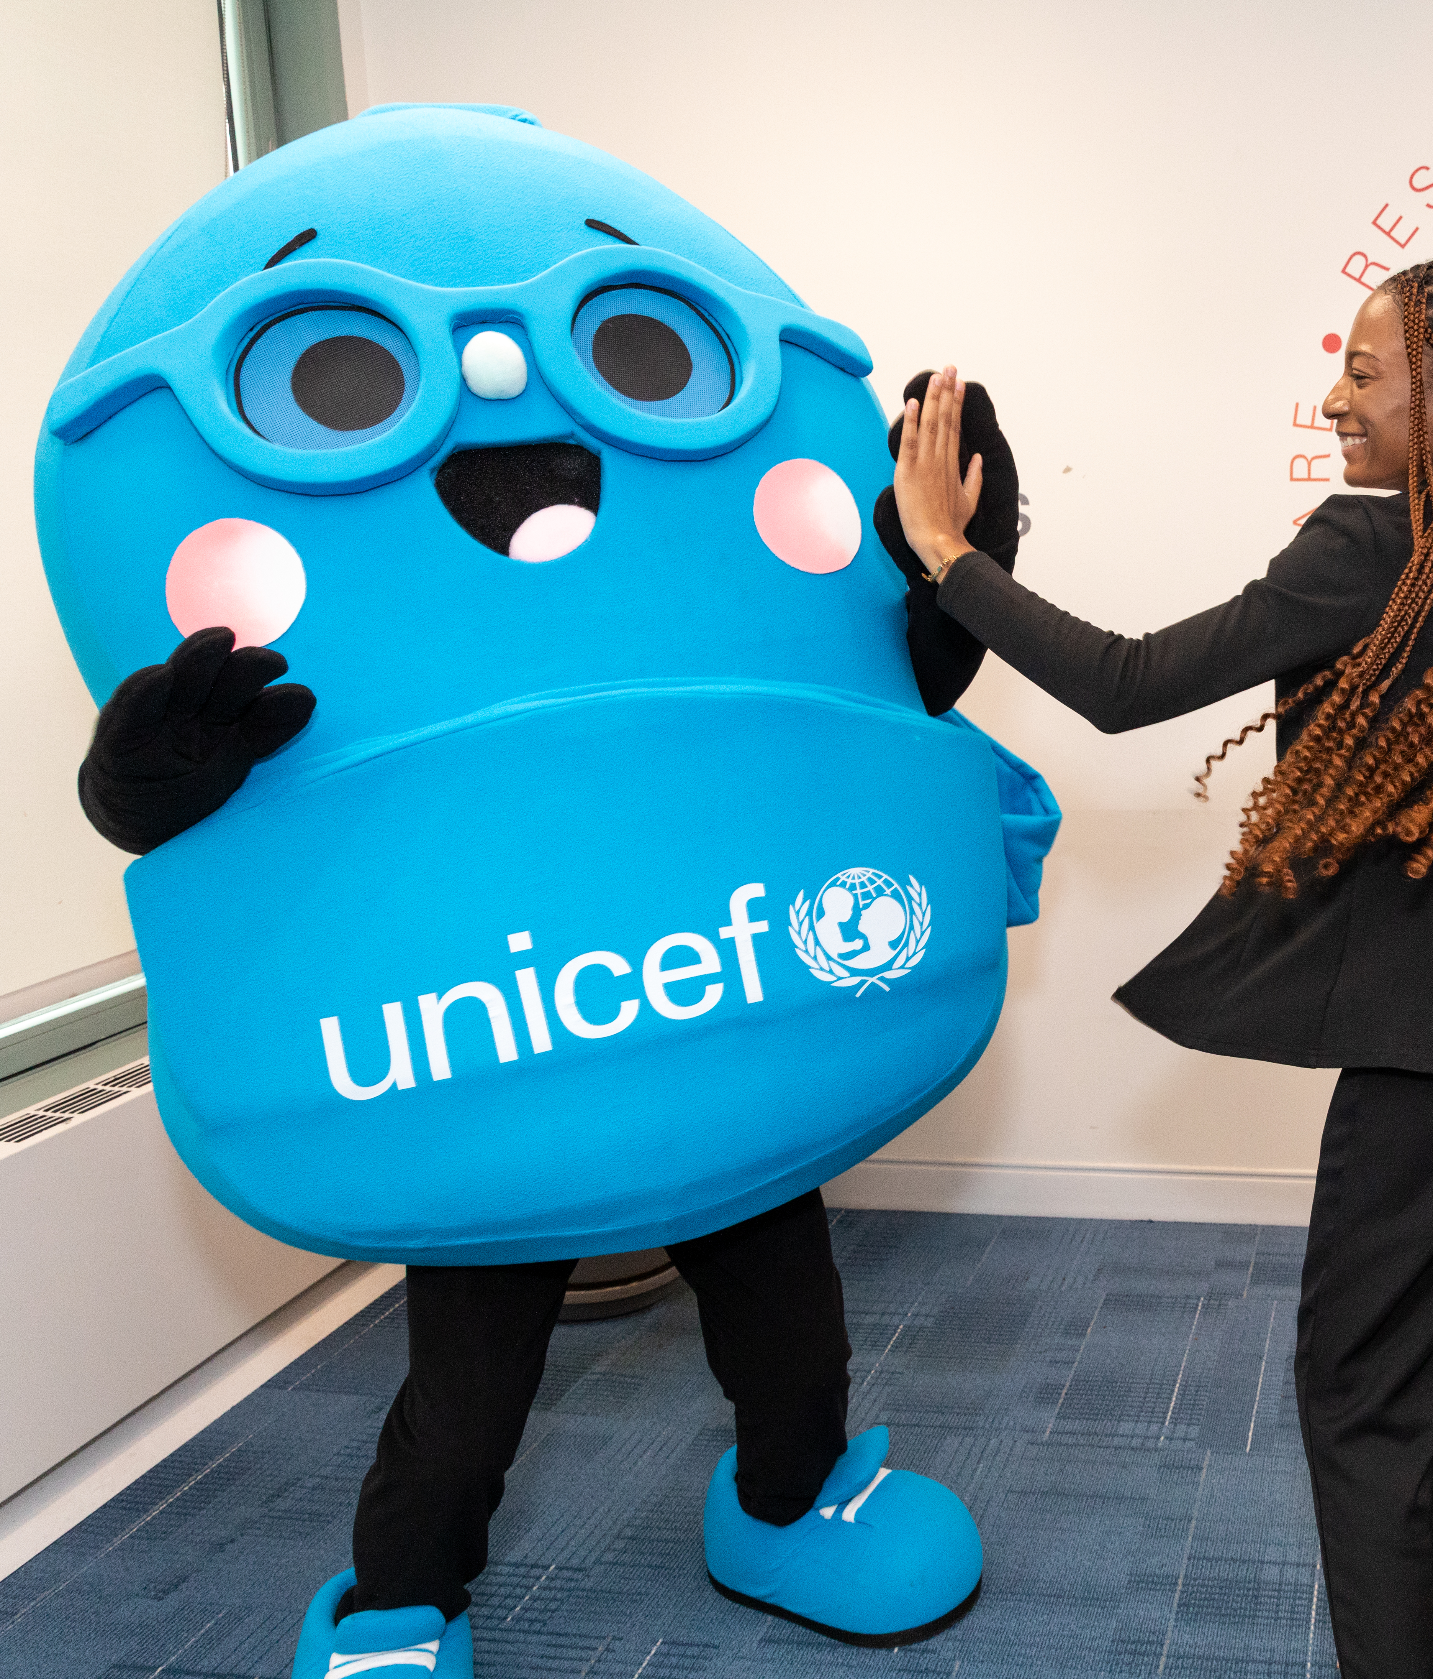
About UNICEF
UNICEF stands for the United Nations Children’s Fund. We were established in 1946 after World War 2 and today we work in nearly every country (more than 190 countries and territories) to protect children’s rights.
Our work includes health, nutrition, water, education, emergency response and so much more. Everything we do is to protect children’s rights around the world.
UNICEF is the only organization named in the Convention on the Rights of the Child as an official expert helper and adviser.
Notes:
Prep Note: Refer to the Rights, Needs and Wants Activity to help explain children rights and the Convention on the Rights of the Child to your students.

Slide 4
Presentations for Classroom Lessons
PART
1

Slide 5
Let’s Visit
Assam, India

Slide 6

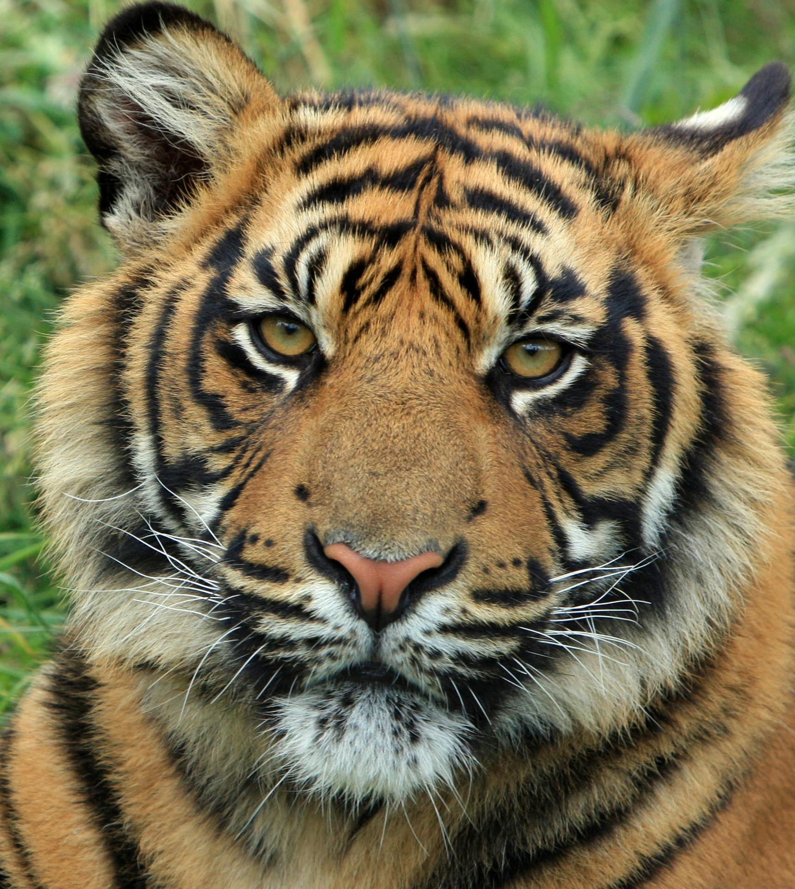

Traveller’s Guide
T
Assam, India
There are 1.4 billion people living in India. India is the country with the largest population in the world.
India gained its independence from British colonial rule in 1947.
Assam State produces more tea than any other state in India.
The Taj Mahal in India is one of the
Seven wonders of the modern world.
121 languages are spoken in India.
The national animal
of India is the tiger,
and the national
bird is the peacock.
India has six weather seasons: Spring, Summer, Monsoon (Rainy Season), Autumn, Pre-winter, and Winter.
Notes:
Prep Note: Edit the facts suit your audience. Boxes can be deleted if you would prefer to focus on fewer facts.
Sources:
There are 1.4 billion people living in India. India is the country with the largest population in the world. https://www.worldometers.info/world-population/india-population/
India gained its independence from British colonial rule in 1947. https://www.bbc.co.uk/bitesize/articles/zn6496f
The Taj Mahal is one of the Seven wonders of the modern world https://www.originaltravel.co.uk/travel-guide/india/fun-facts
121 languages spoken in India. https://rubric.com/en-us/how-many-languages-in-india/
India has six seasons, not four. India’s traditional calendar recognizes six seasons: Spring, Summer, Monsoon, Autumn, Pre-winter, and Winter. https://www.globaladmissions.com/blog/50-incredible-facts-about-india
India’s national identity is celebrated through its symbols: https://www.globaladmissions.com/blog/50-incredible-facts-about-india
Tiger (stands for strength)
Lotus flower (stands for purity)
Peacock (stand for beauty)
Assam state produces more tea than any other state in India. http://www.agriculturejournal.org/volume13number3/dynamics-of-tea-production-in-assam-a-time-series-forecasting-approach/

Slide 7
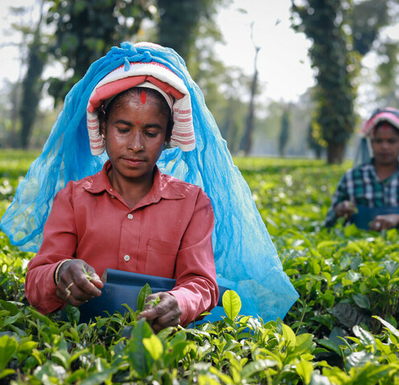
Picking Tea in Assam
Most parts of India are hot and have lots of rain. This weather is ideal for growing tea.
Assam is a place in India where a lot of tea is grown.
Tea is mostly grown on large plantations called estates. The leaves are picked by hand, and it is hard work.
Many estates are very large, so families often live nearby so they can walk to work easily.
Women picking tea leaves in a tea estate in Assam, India.
Notes:
Prep Note: There is a glossary in later slides, should you want to explain any certain terms to pupils

Slide 8


UNICEF India and the Ethical Tea Partnership
UNICEF India works to support children's rights in India.
The Ethical Tea Partnership (ETP) helps tea workers and their families in India. They help make sure people who pick tea get fair pay, work in safe places, and protect nature.
The Improving Lives Program
UNICEF India and ETP created The Improving Lives Program which helps children and families living in 204 tea estates in Assam.
The Improving Lives Program helps families living on tea estates by giving them better healthcare, food and helping children go to school. They want to make life better for families so children can grow up healthy, happy and safe.
Notes:
Background Notes: The ETP focuses on long term change so that everyone who works in tea-producing regions can have a better standard of living and working conditions, while helping the tea sector become more sustainable for the future. In comparison, Fairtrade and Rainforest Alliance are certification organisations. This means they set standards and allow products to carry a label if they meet those standards. Whereas the ETP works with the tea industry to drive change across the whole sector.
Prep Notes:
To find out more about the Ethical Tea Partnership, click on this link: https://etp-global.org/
To find out more about the Improving Lives Program click on this link: https://etp-global.org/our-initiatives/unicef-improving-lives-women-children-phase-iii/
Sources:
To find out more about the Ethical Tea Partnership, click on this link: https://etp-global.org/
To find out more about the Improving Lives Program click on this link: https://etp-global.org/our-initiatives/unicef-improving-lives-women-children-phase-iii/
Manitoba Food Service Certifications: https://www.mcic.ca/news/82/shopping-fair-and-sustainable-in-a-world-of-logos

Slide 9
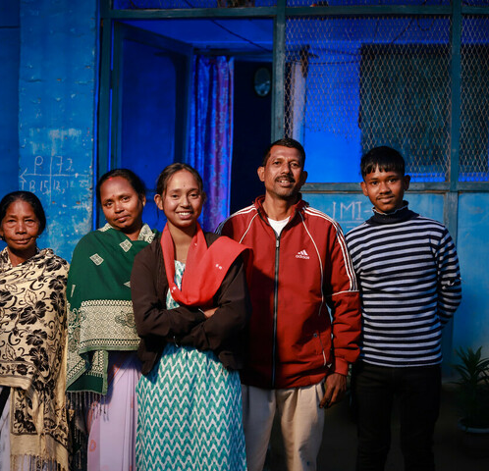
Ankita's Story
Ankita lives with her family on a tea estate in Assam, India.
Both of her parents work in the tea estate.
Ankita wanted to learn about computers, but her parents didn’t have enough money to pay for the computer class.
Ankita, with her parents, brother and grandmother.
Notes:
Prep Notes: Slides 8-11 are a simplified version of Ankita's Story for children in early years settings and/or those more confident with simpler concepts. Slide 12 contains a more complex version of the story, which teachers might be interested to view for context. Here is the video link:https://youtu.be/7Hh-5zbK1mk?si=kmqiZx4Klt5UFm-x

Slide 10
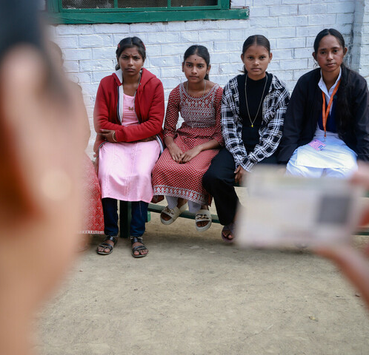
Ankita's Story
Ankita joined a youth group aimed at supporting girls.
The group helped her learn that to get money for school you need something called an 'identity card' and a 'bank account'
With help from the group, Ankita opened a bank account. This helped her get money called a 'scholarship' to pay for computer classes.
Ankita and friends at the youth group

Slide 11
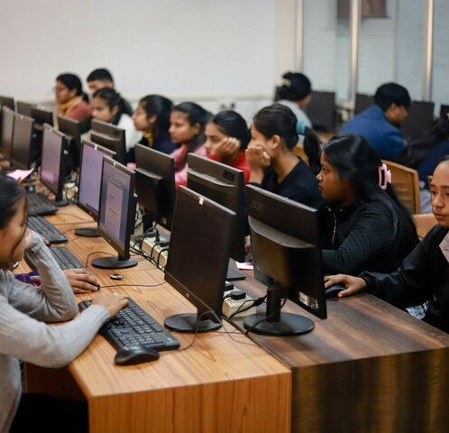
Ankita's Story
With the scholarship, Ankita joined a computer class.
She also helped one of her friends learn about scholarships so that she could join the class.
Ankita used the rest of the scholarship money to buy books and save up for college.
Ankita's computer class

Slide 12
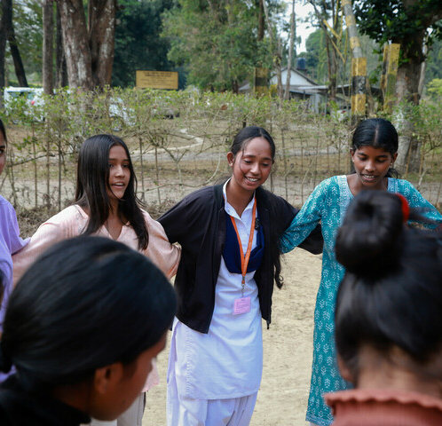
Ankita's Story
Ankita is now a leader at the youth group. She helps other girls open bank accounts and get scholarships too.
Ankita said:
“Many girls are too shy to come out, ask questions and talk to people. We bring them to the youth group, so we can learn together.”
Ankita and friends at the youth girls Group.

Slide 13
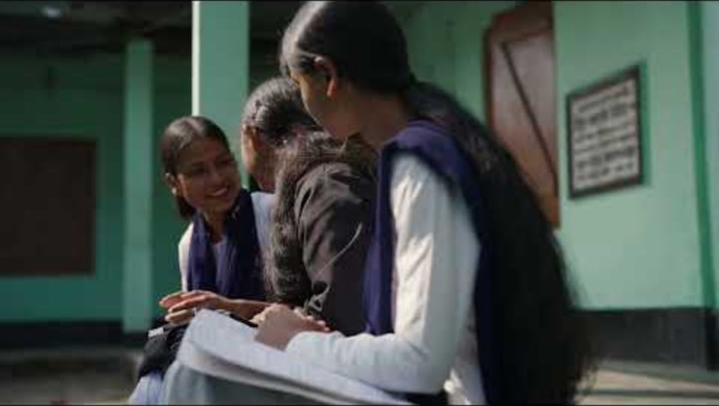
Ankita’s Story
Ankita lives with her family on a tea estate in Assam, India. Ankita wanted to learn about computers, but her parents did not have enough money to pay for the computer class.
With the help of her youth group and the Improving Lives Program, Ankita was able to access a scholarship to pay for the computer class. She also supported other girls to learn about and access scholarships.
In Ankita’s words:
“Many girls are too shy to come out, ask questions and talk to people. We bring them to the Youth Group, so we can learn together.”
Notes:
Prep Note: This slide is a more complex version of Anikta's story for a higher level of understanding.
Background Note: Read more about Social inclusion initiatives in Doomur Dullung Tea Estate, India: https://etp-global.org/stories/improving-lives-programme-social-inclusion-initiatives-in-doomur-dullung-tea-estate-india/

Slide 14


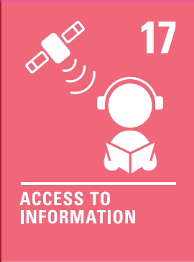

The Rights Link...
Think about the rights that you know.
Which articles of the Convention on the Rights of the Child (CRC) are particularly relevant to this case study?
Why do you think we’ve highlighted this selection?
Did you identify others?
Notes:
Prep Note: You may wish to have copies of the CRC available if your students are less familiar with the articles from the convention.
Animation Note: Click to reveal some examples.

Slide 15
...and what about the Global Goals?
Why do you think we’ve highlighted this selection?
Did you identify others?
Notes:
Prep Note: If your students are not currently familiar with the Sustainable Development Goals, please remove this slide or refer to the additional context provided in the Educator Resource Kit. To find out more about the Global Goals: https://worldslargestlesson.globalgoals.org/ or https://globalgoals.org/.

Slide 16
...and what about the Global Goals?
Why do you think we’ve highlighted this selection?
Did you identify others?

Slide 17
Reflection
Think back to what you have learnt about India, Assam, Ankita and the work of UNICEF and the Ethical Tea Partnership.
Is there anything that surprised you or you thought was particularly interesting?
Is there anything you would like to learn more about?
Notes:
Prep Note: Before ending the session, encourage students to reflect on what they have learnt. You could ask them to share their reflections in pairs, small groups or to the whole group.

Slide 18
Activities
PART
2

Slide 19
Build Your Understanding
What do you know about India? Watch some more videos from UNICEF India and discuss what rights are being protected. What can you find out about children's lives in India?
Ask an adult to show you some of the boxes of tea from the staffroom or from home or visit your local supermarket. Does the tea box say whether the tea producer is part of the Ethical Tea Partnership or can you see a Fairtrade or Rainforest Alliance logo? Why is it important to make sure the people who grow the tea are treated fairly?
Ankita is part of a girls' group in her tea estate. In many parts of the world, girls and boys are still given different opportunities. Can you think of ways boys and girls are sometimes treated differently? Why is it important to make sure all children are treated fairly?
Ankita wanted to do a computer class to develop her skills. Do you do any clubs in the evenings or on the weekends? What amazing skills do you have? You could create a display of all the different skills you and your classmates have.
Notes:
Prep Note: The activities here will support students to explore this topic in more detail. Choose one or more activities as featured here or amend them to suit your class. You could also create your own activities inspired by the presentations in part one.
Additional Consideration: The way the picture story is told for the youngest group does not explicitly refer to discriminatory treatment of girl - give some thought to discussing gender equality/equity with your class.

Slide 20
Build Your Understanding
Ankita faced barriers to accessing her right to education. Think about the different barriers she faced and how she overcame these barriers to achieve her goal. You could plot this out on a piece of paper and make links to CRC articles.
Ankita was part of a girls' group and wanted to take part in computer lessons. What clubs or activities can you join at school? Does your school have students running or supporting the activities? Think about how you could be more involved or suggest a club that you would like to have at school. Create a proposal for a new club.
Ankita is part of a girl's group in her tea estate. In many parts of the world, girls still face discrimination and need extra support to achieve their goals (equity). Every October 11, we celebrate International Day of the Girl to recognize the achievements, opportunities, and challenges impacting girls and young women.
Research a woman leader who has overcome challenges to achieve fantastic things.
Antika had to have an identity document (ID) to get a bank account. Talk about identity documents, what they are e.g. passports, birth certificates, and why they are important. Create your own ID document by drawing a self-portrait and adding things that are important to you such as family, friends, special items and places.
Notes:
Prep Note: The activities here will support students to explore this topic in more detail. Choose one or more activities as featured here or amend them to suit your class. You could also create your own activities inspired by the presentations in part one.

Slide 21
Build Your Understanding
Find out more about the Ethical Tea Partnership. What does it aim to do and how does this support children’s rights? How is this different to Fair Trade or the Rainforest Alliance? You could create a table to compare and contrast the different ideas and then think about how to encourage people to be aware of them when they buy tea.
Ankita was part of a girl's club in her tea estate, linked to Article 15. Survey your friends to see if there is a club that they would like to see in school. Create a proposal for a new club, including any relevant details on potential barriers to overcome, funding, venues, staffing, accessibility, equity etc. Pitch your idea to your teachers and see if you can get your club up and running.
Why do you think there is a girl's club in the Tea Estates? Read about UNICEF’s work on gender equality and then discuss why this is particularly important for teenagers. Think about Article 2 and discuss or write about how we can support all children and young people to achieve their potential.
Article 28 says that primary education should be free and compulsory, but that secondary education should be available and accessible to every child, with financial assistance available in case of need. UNICEF and ETP's program supported Ankita to access education through a scholarship fund. Find out more about how many children across the world access secondary education and think about how you could campaign for access to be increased.
Notes:
Prep Note: The activities here will support students to explore this topic in more detail. Choose one or more activities as featured here or amend them to suit your class. You could also create your own activities inspired by the presentations in part one.

Slide 22
Take Your Learning Into the World
Inform!
Buy fair trade items! There are many options when buying fair trade, especially when splurging on luxury items. Encourage yourself and others to buy fair trade during gift giving events. Consider buying directly from farmers at local markets when possible.
Action!
Talk to your favourite local vendors about supplying fair trade items. Become an ethical shopper and have some say in the market by sending a letter, email or chatting face to face with your local favourite vendor. Brainstorm a list of places who would be eager to hear from you!
Notes:
Background Note: Learn more about Fair Trade through resources from the Manitoba Council for International Cooperation (MCIC): https://www.mcic.ca/sustainability/fair-trade#faq-question-21

Slide 23
Kickstart a UNICEF Campus Club at Your School
Your ideas belong here.​
Bring students together to stand up for every child’s rights, including the right to learn. Create a welcoming club where everyone can contribute.​
Learn together, speak up about issues you care about and fundraise to support UNICEF’s work for children.​
Ready to start? Gather a small leadership team, explore the How to Start a Club Guide and register your club.​
unicef.ca/en/unicef-campus
Notes:
Background Note: Educators play an important role in helping young people discover opportunities to lead and make an impact in their communities. UNICEF Canada Campus Clubs provide a structured and supported way for students ages 13-24 to explore global citizenship, child rights, advocacy, and fundraising while connecting with youth leaders across Canada. For additional context and program details, please review the accompanying Campus Club resource, which outlines the benefits, requirements, and supports available to participating schools and students.

Slide 24


THANK YOU
Credit Note: Country Pack adapted from UNICEF UK Rights Respecting Schools Award Program
U N I C E F . C A

Slide 25
Glossary
Ethical: What is morally right. Acting in a way that treats people and the environment well.
Tea garden: A place where tea plants are grown and people work picking the leaves.
Tea estate: The tea gardens and surrounding areas where the people who work in the tea gardens live their lives.
Equity: When things are fair, and all people have the same opportunities as others.
Financial literacy: Understanding money - how to earn, spend, save, and manage it wisely so you can make good decisions in life.
Scholarship: Money or support given to help someone go to school, college, or learn new skills, especially if they wouldn’t be able to afford it otherwise.

Slide 26
Glossary
Fair trade: Fair Trade is a partnership between companies and producers to ensure fair wages and safe working environments. A product can be fair trade but does not need to be organic or local.
Organic: : An organic product is produced without the use of chemicals, pesticides, and fertilizers. There are some products that are organic and fair trade, or organic and local, but not all products are.
Local: A local product is exclusively from a particular area or neighbourhood, usually within a few hours driving distance of the consumer’s location. A local product may be fair trade and organic, but not always.

